Slide 1
GROUP-N
Kotra Sree Ranga Ketan - 200423849
Ganesh Kumaran Masilamani -200434339
Rochelle Robb - 150388670
Atul Yadav - 200349549
SEARCH ENGINE IMPLEMENTATION
FINAL PRESENTATION
IMAGE SEARCH ENGINE

Slide 2
Introduction and techniques implemented
Image Retrieval is becoming increasingly important now a days.
The organization of images is becoming a prominent area of study and a more essential part to the topic of Image Retrieval.
DATASET USED:
We are using Image dataset downloaded from the vision.cs.uiuc.edu website, which consists of 1000 images.
TECHNIQUES EMPLOYED:
Generate features
Indexing features
Building word index
Retrieval

Slide 3
INDEXING STEPS
Training data is fed into the model
Training labels are fed into Glove embeddings(300 dimensional vectors)
Both train data and labels are feed into image index ( built using annoy which is a spotify opensource image index model), uses locality sensitive hashing algorithm for indexing.
Loading VGG model
Training images
VGG model
Image Indexing
Training labels
Glove embedding

Slide 4
SEARCH (RETRIEVAL) FLOW
In search, We use VGG model to get the Query representation into 4096 vector and fed into image index
Image Index uses Approximate nearest neighbour method (ANN) to find the similar images according to the query.
Load VGG model
Query Image
VGG model
Image Index
Query Results (similar images)

Slide 5
EVALUATION (Retrieval)
For evaluation, our Engine uses the Approximate nearest neighbour algorithm
Approximate nearest neighbour search algorithm
Approximate nearest neighbour algorithm returns the datapoint of the query according its distance.
For the query results, It takes the distance from the query is at the more times the distance to its nearest datapoints.
It accurately takes the perception of the user query.
It is capable of solving Multiclass classification tasks.

Slide 6
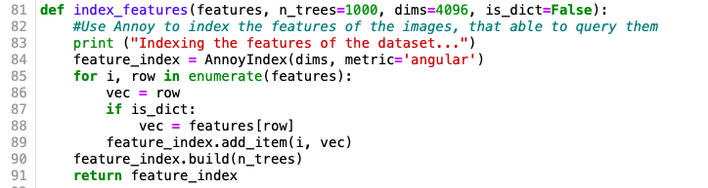
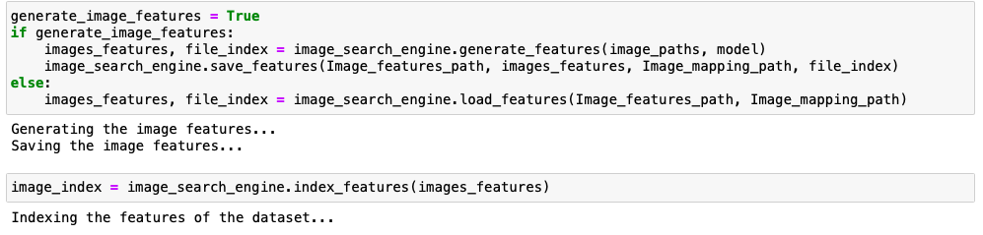
INDEXING THE FEATURES
GENERATE FEATURES AND INDEX FEATURES

Slide 7
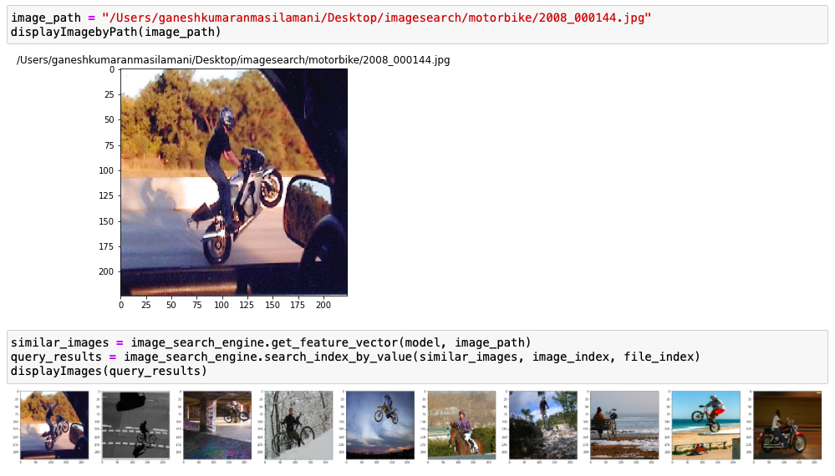
INPUT QUERY AND ITS OUTPUT

Slide 8
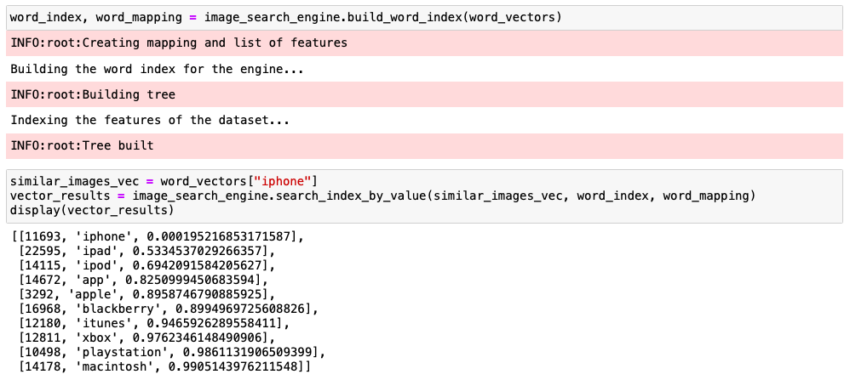
SIMILARITY INDEX

Slide 9
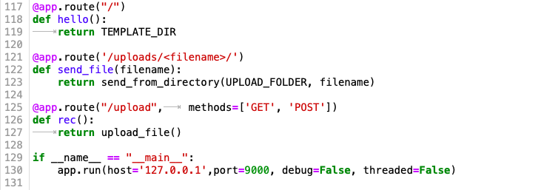
WEBSITE IMPLEMENTATION

Slide 10
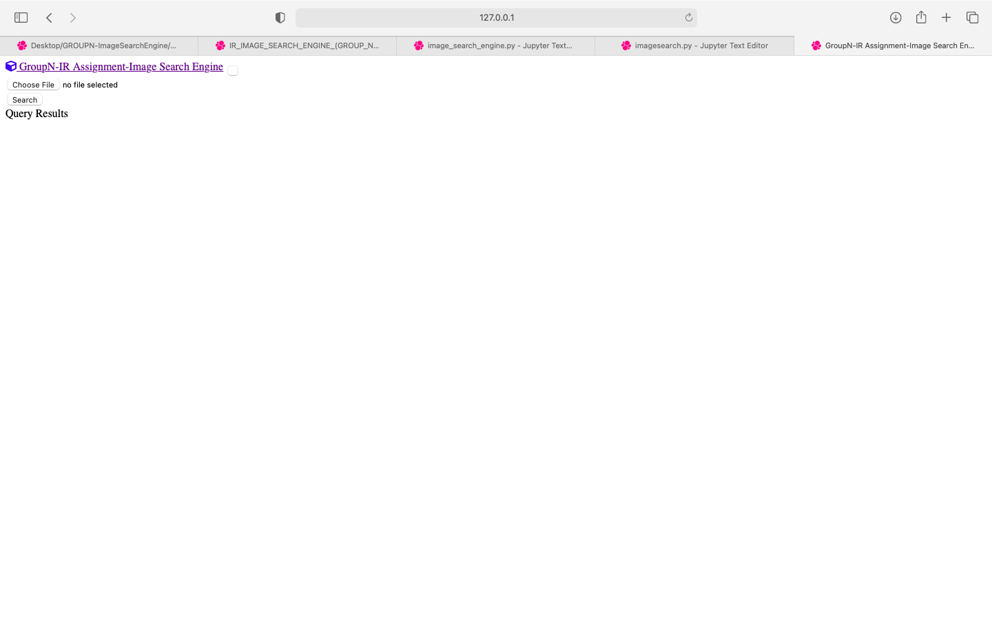
WEBPAGE DESIGN

Slide 11
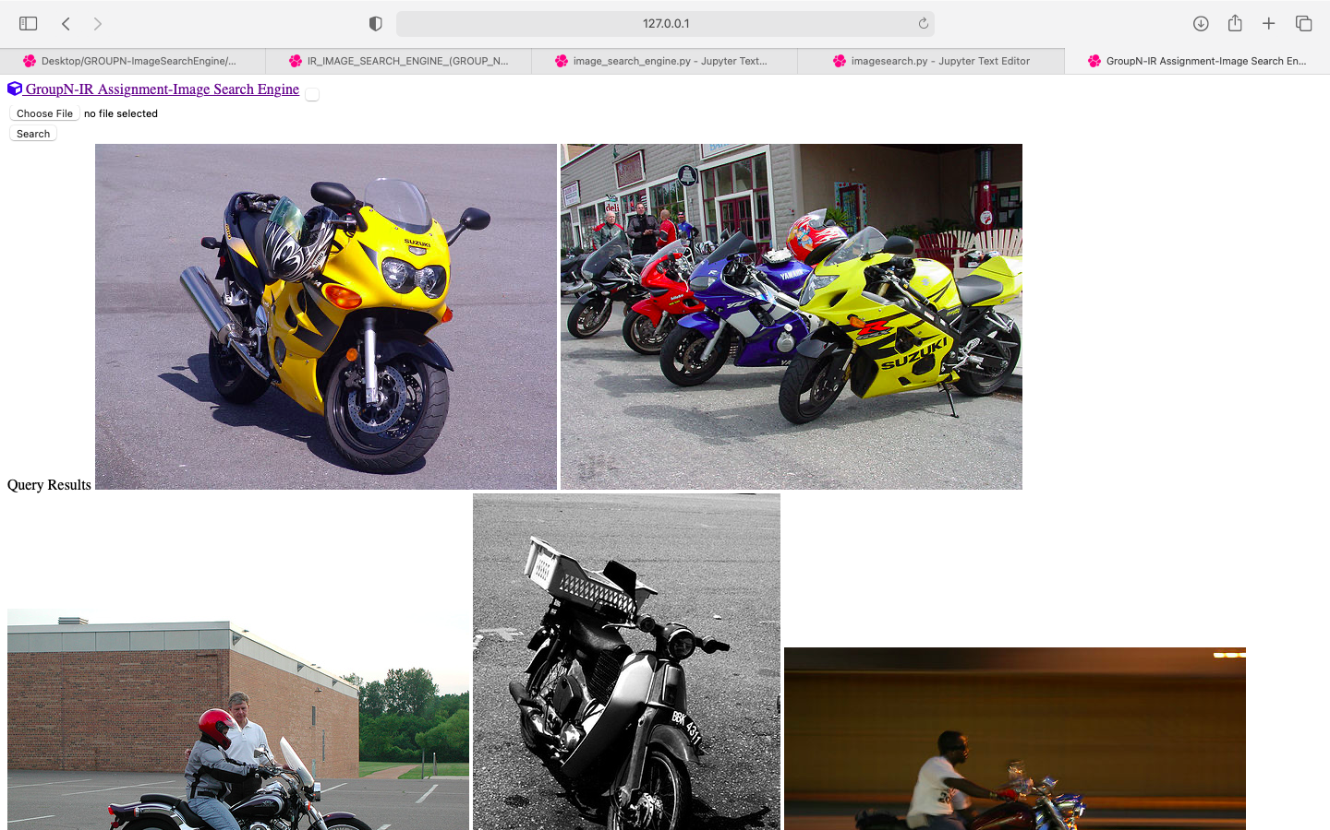
WEBPAGE OUTPUT

Slide 12
PACKAGES AND SOFTWARES USED
BACK END:
Python
Node JS
JSON
FRONT END:
Javascript
CSS
HTML

Slide 13
DEMONSTRATION
BackEnd
FrontEnd
Webpage Design

Slide 14
INDIVIDUAL CONTRIBUTION
Kotra Sree Ranga Ketan (25%) | Study of dataset used for search Engine Query Formulation Study of retrieval techniques Help in Website development Preparation of slides for search engine and explained the indexing part in the presentation.
Ganesh Kumaran Masilamani (25%) | Study of framework Creating the custom Architecture model for evaluation. Indexing of Queries Development of website for ImageSearch Engine Preparation of slides for search engine demo and demonstrated our working of search engine
Rochelle Robb (25%) | Retrieval and similarity indexing of query results Help in Website Development Evaluation of developed engine Explained the search flow of our engine
Atul Yadav (25%) | Loading the dataset for the query Deploying the indexing methodologies with ranking algorithm for search engine Query Formulation Preparation of final presentation slides and discussed the results

Slide 15
THANK YOU!

